Slide 1
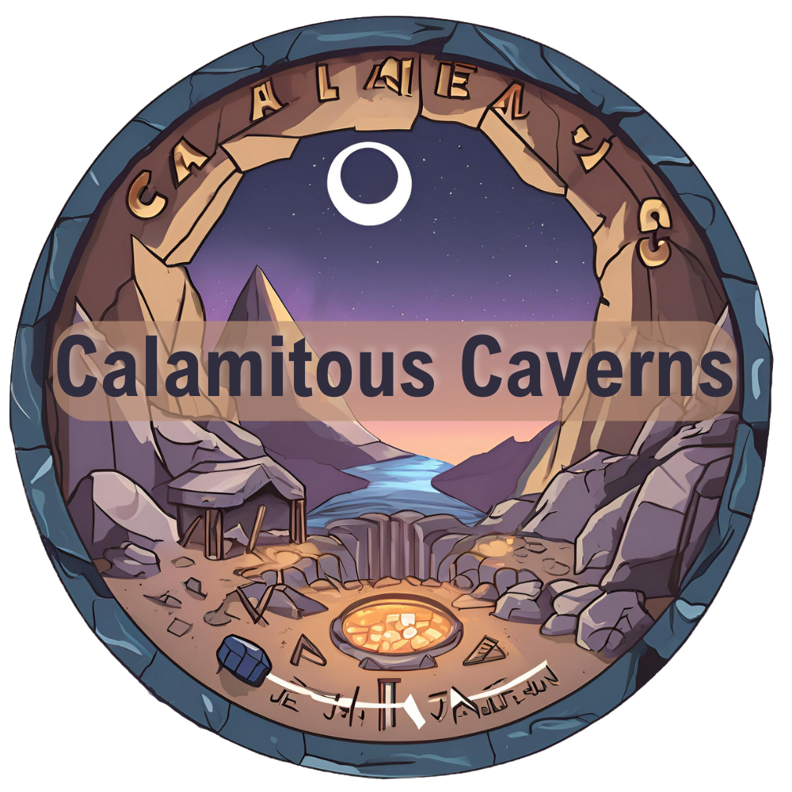
Raphael Shrestha

Slide 2
Overview
Mining​
Inventory​
Buy & Sell system​
Hot-bar​
Quota​
Day/Night cycle​
Multiplayer​
Level Streaming

Slide 3
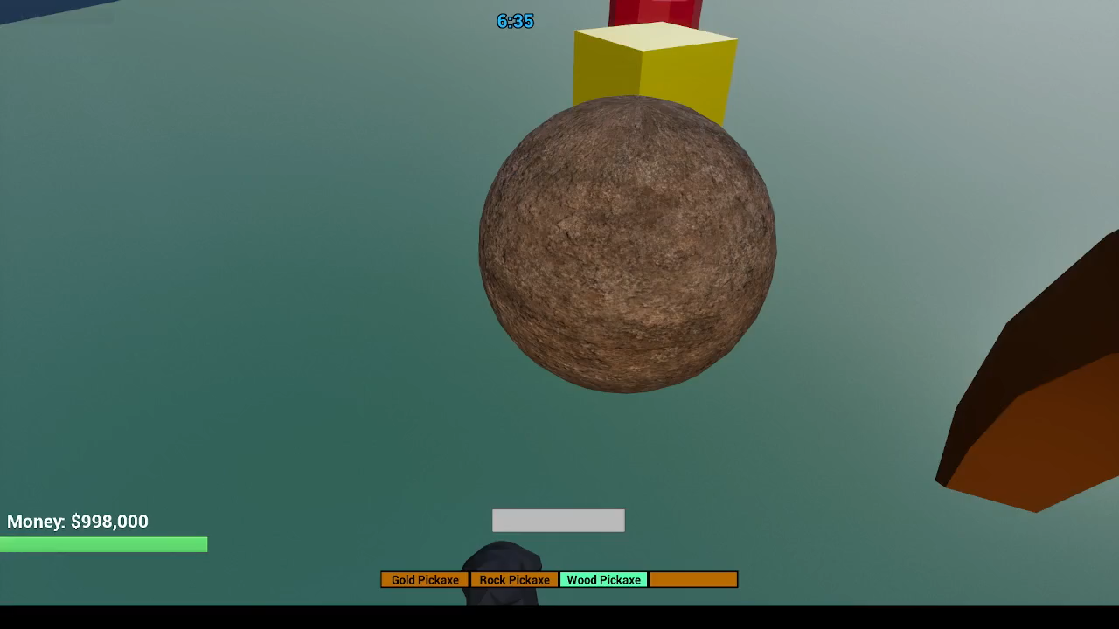
Mining

Slide 4
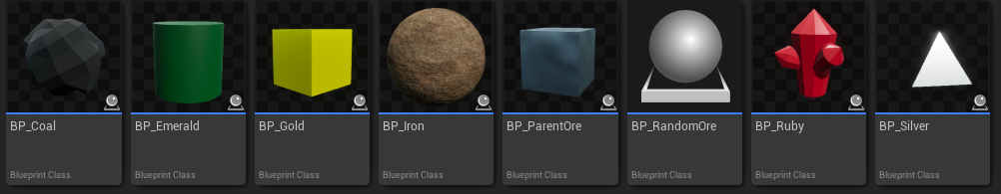
Parent Ore
Inheritance
Children Actor ->
On Collision

Slide 5
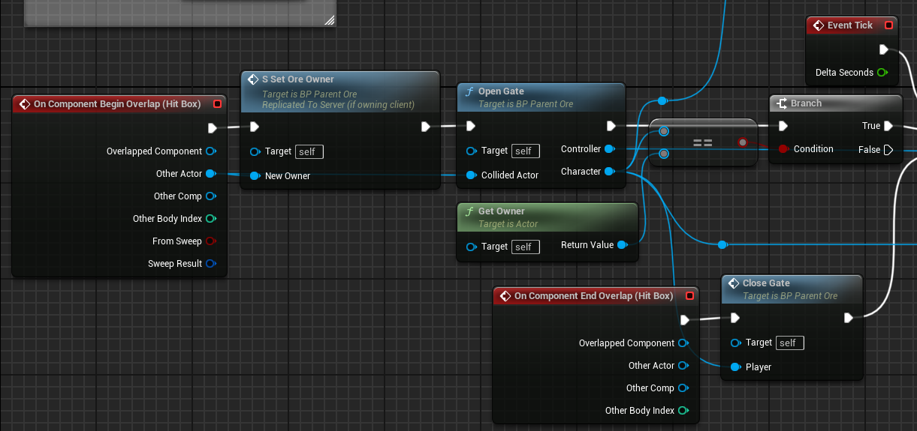
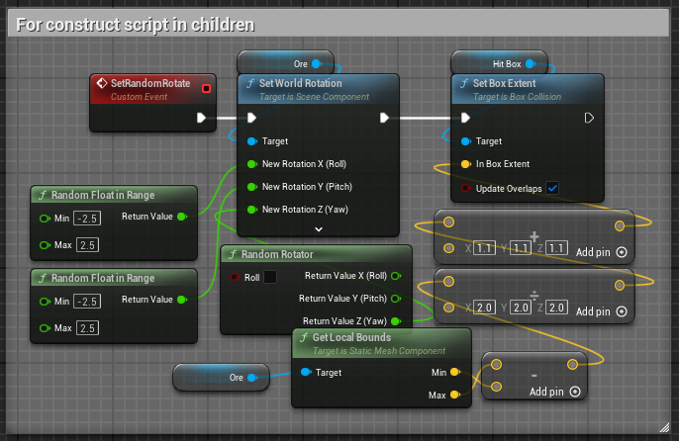
Logic
Collision Gate
Ownership
Dynamic Spawn Transform

Slide 6
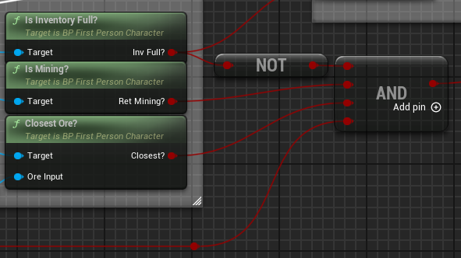
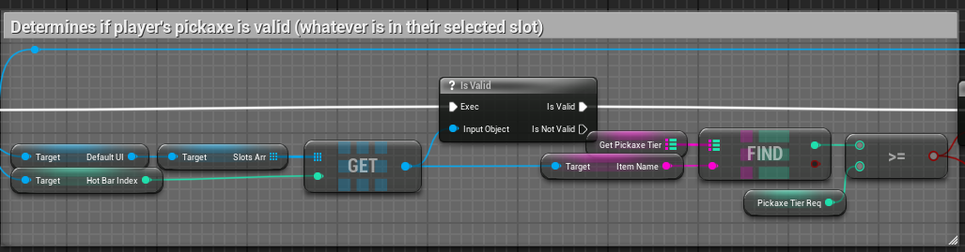
Parameters
Verifying parameters
Inventory status
Player input
Correct actor
Pickaxe validity

Slide 7
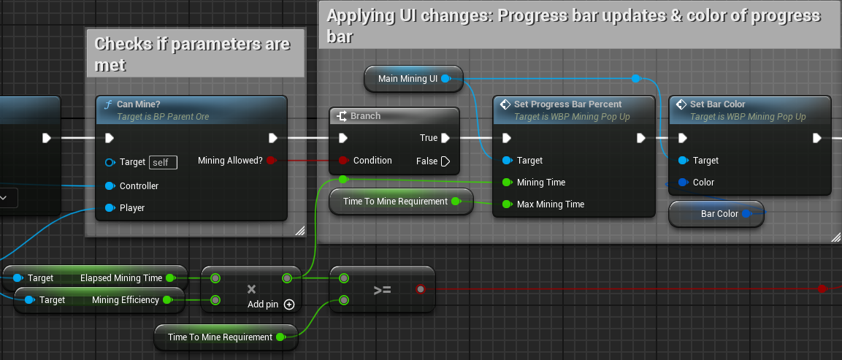
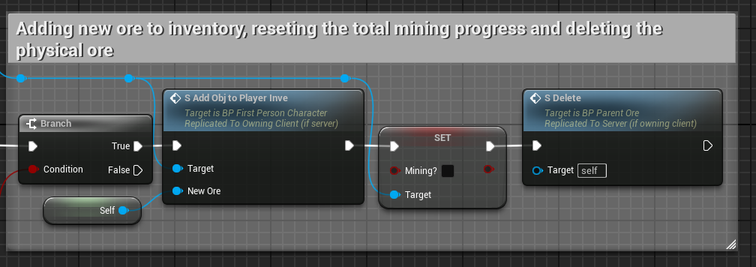
Mining UI
Progress bar updating
Add to inventory and delete actor after meeting time requirement

Slide 8
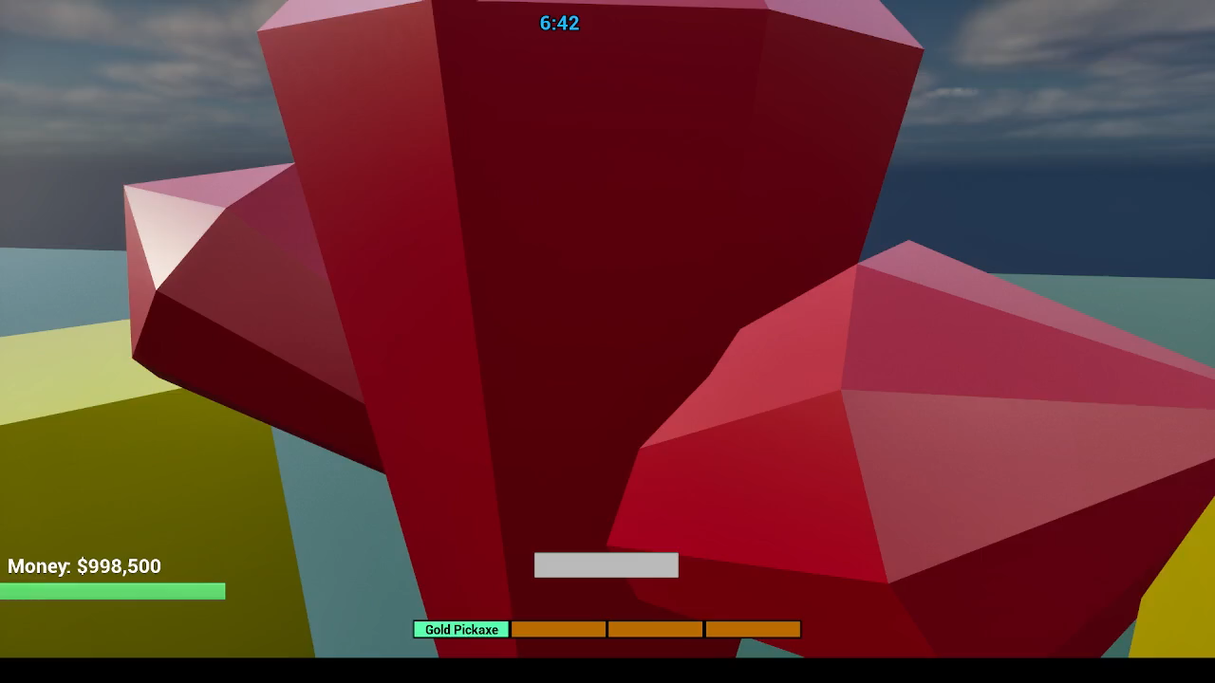
Inventory

Slide 9
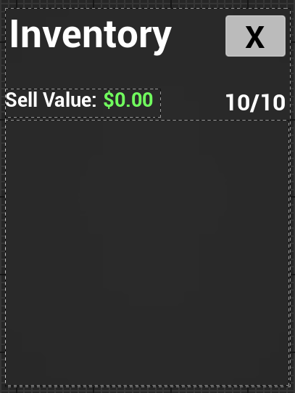
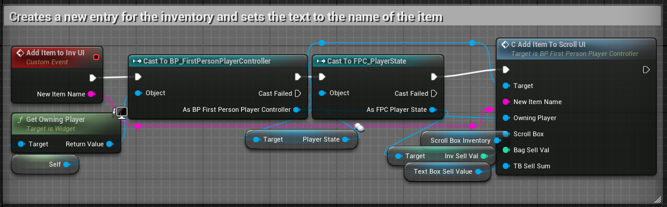
Inventory UI
Basic UI
Scroll box
RPC to add new widget to UI

Slide 10
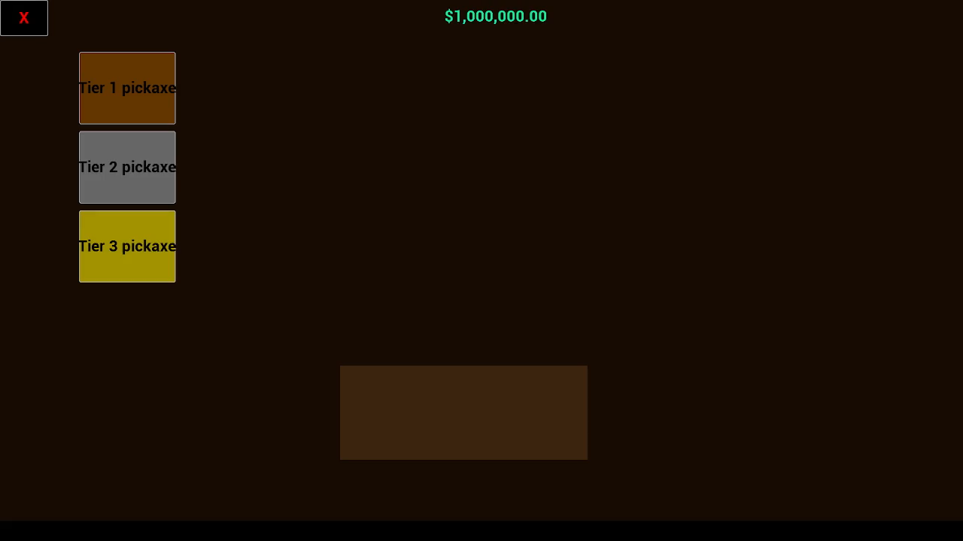
Buy & Sell system

Slide 11
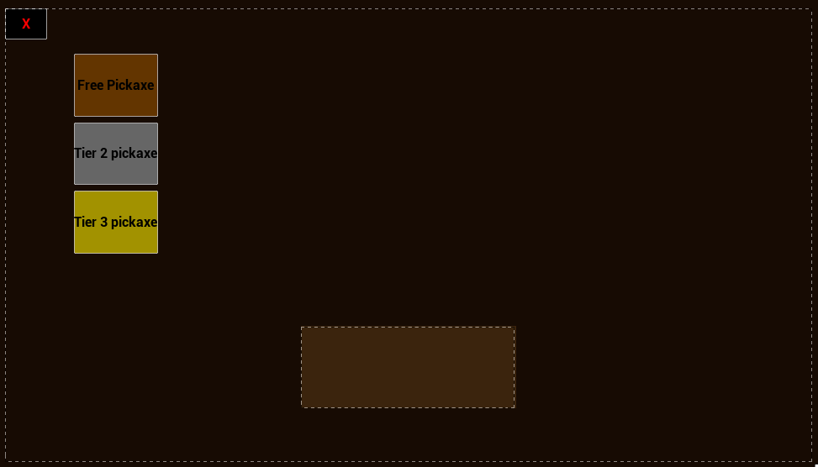
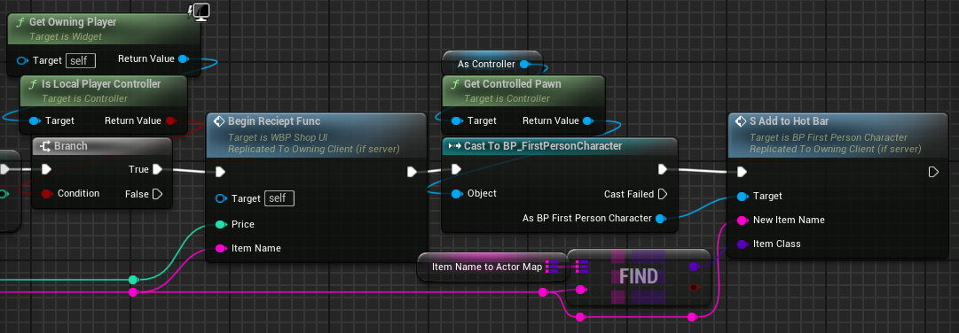
Shop UI
Buy Logic
Adding to Hotbar UI
Adding Static Mesh to Hotbar array

Slide 12
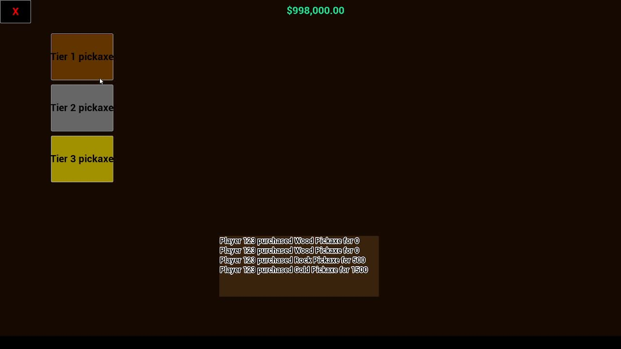
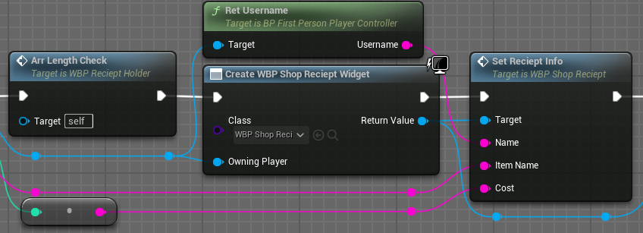
Shop Logic
Generating receipts per purchase
(Not multiplayer functional)

Slide 13
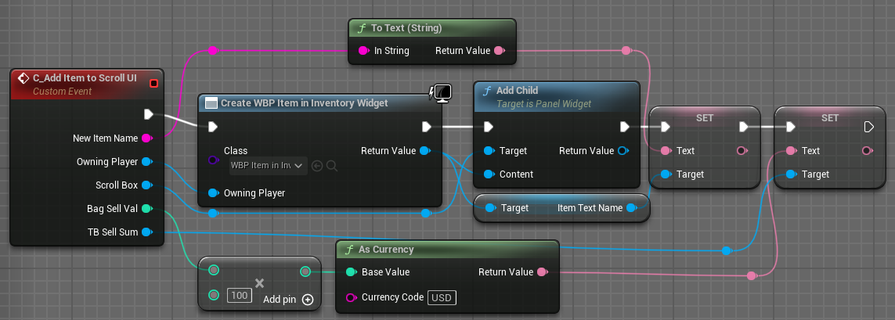
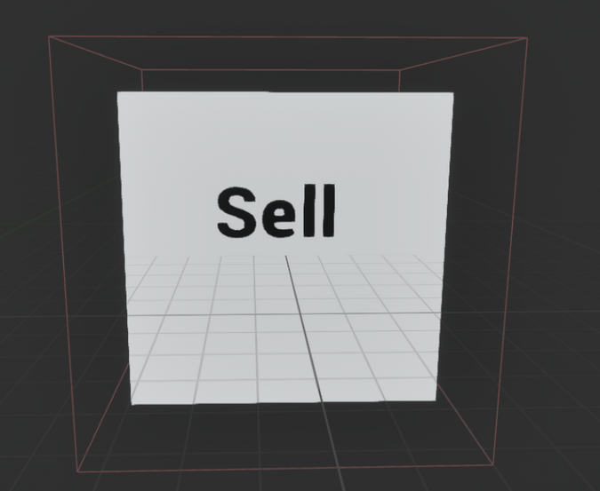
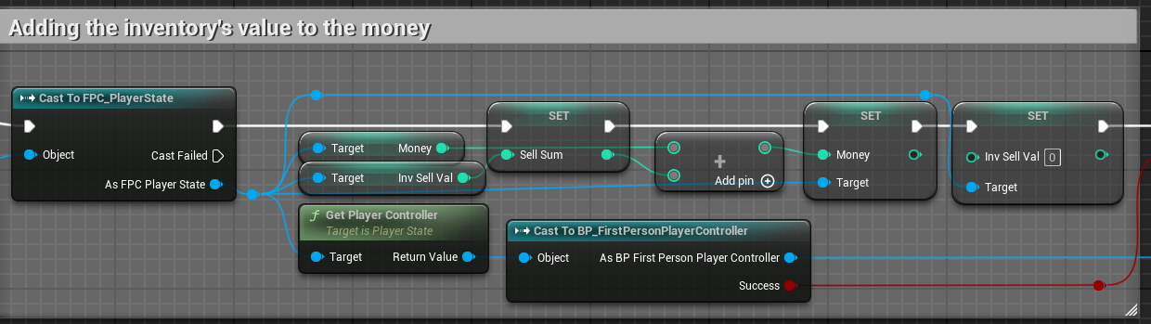
Sell Logic
Inventory sell value
Sell area

Slide 14
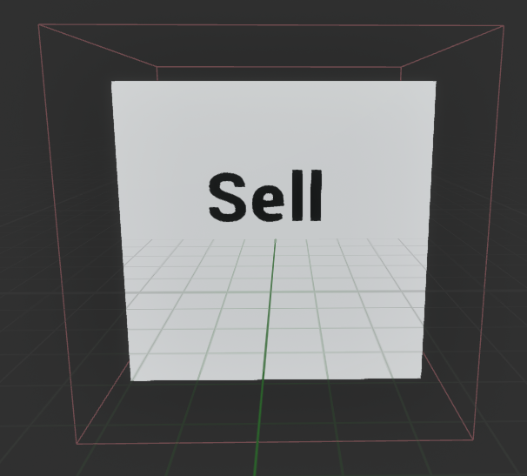
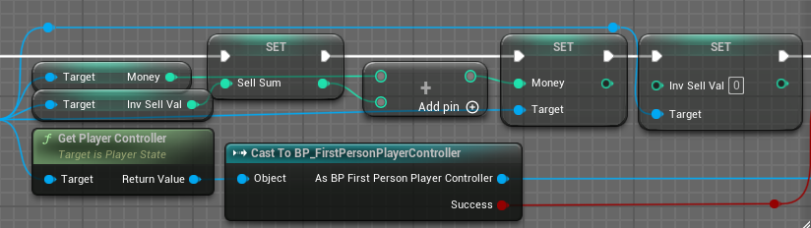
Selling area
Finds total value of player inventory and adds to their money

Slide 15
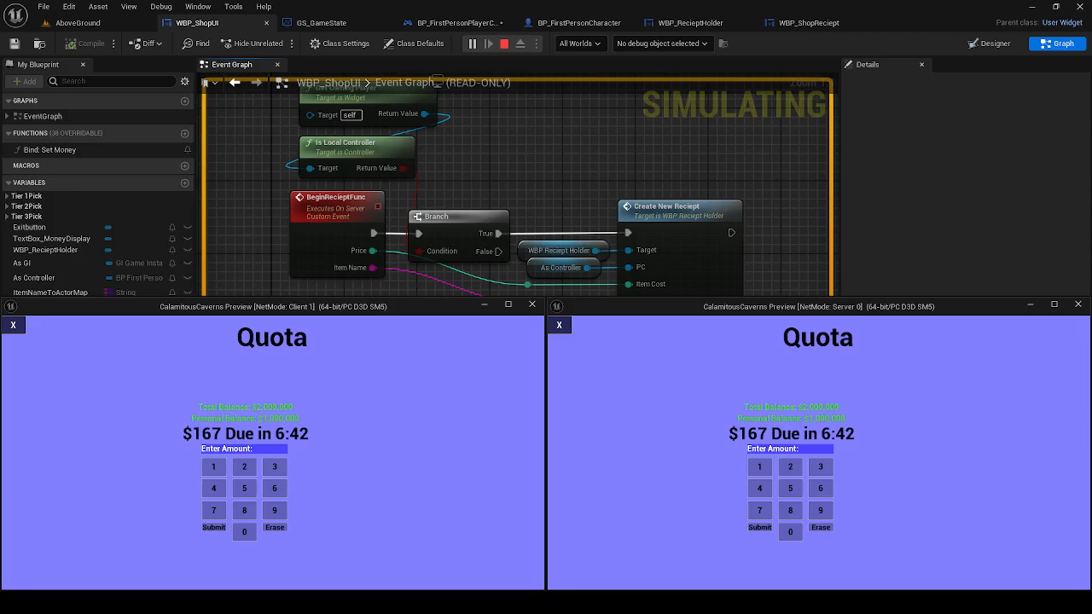
Quota

Slide 16
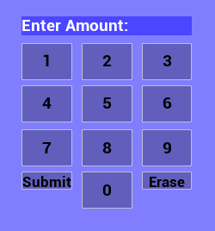
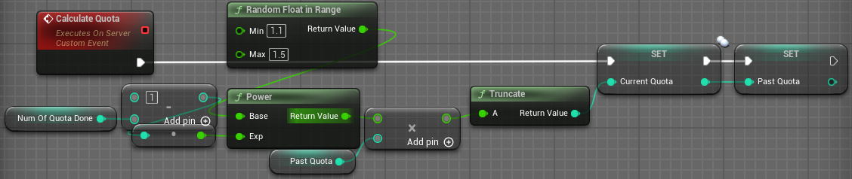
Quota
Formula
Scales w/ days passed
On Game State (RPC)

Slide 17
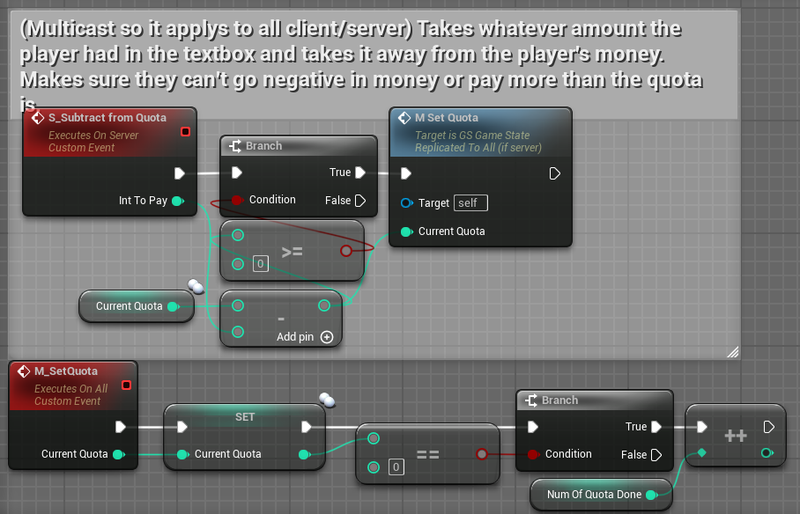
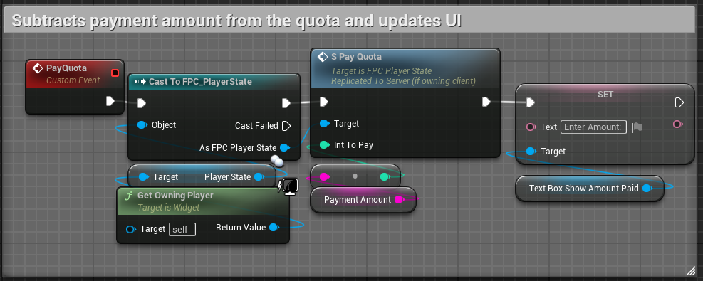
Quota
RPCs to show changes per player in real time
More RPCs to pay/make changes to the quota

Slide 18
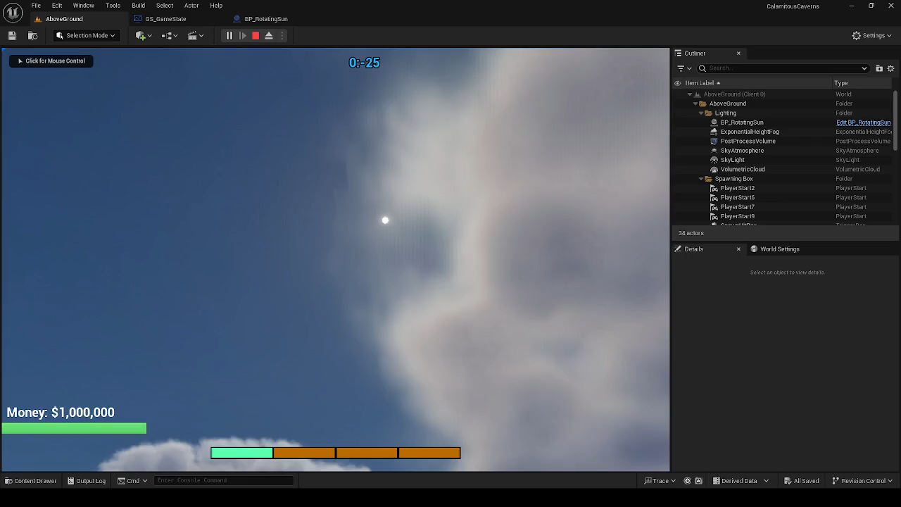
Day/Night Cycle

Slide 19
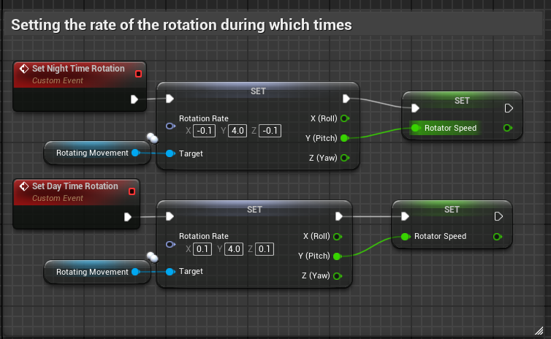
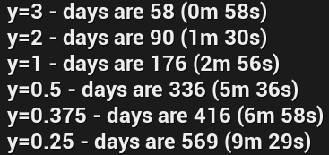
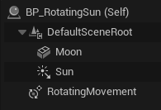
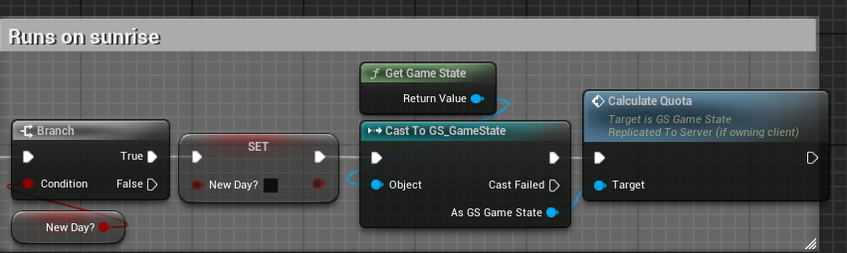
Rotating Logic
Uses rotator w/ set values
On sunrise (new day) the quota is calculated again
Updates time on tick for Quota purposes

Slide 20
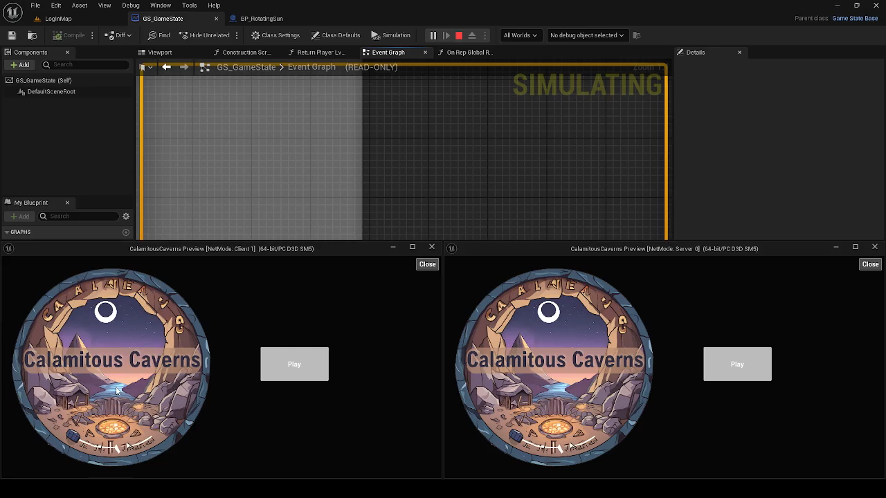
Multiplayer

Slide 21
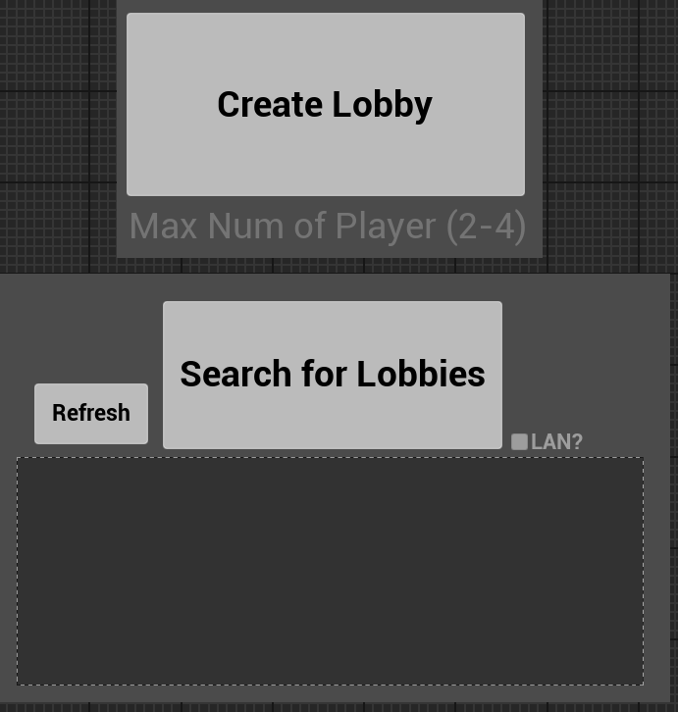
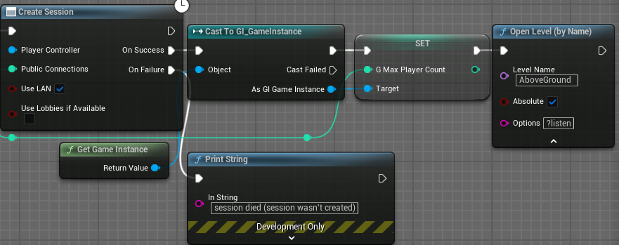
Session System
UE5 Integrated system
Main Menu UI to use system

Slide 22
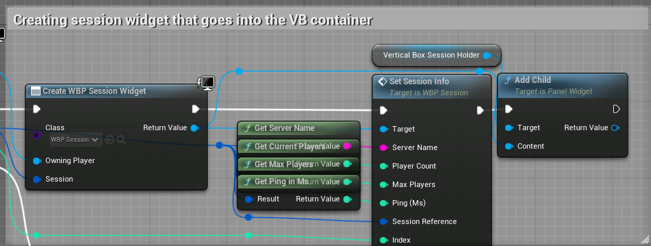
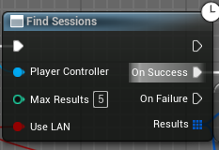
Session System
UE5 Integrated system
Main Menu UI to use system

Slide 23
Hotbar

Slide 24
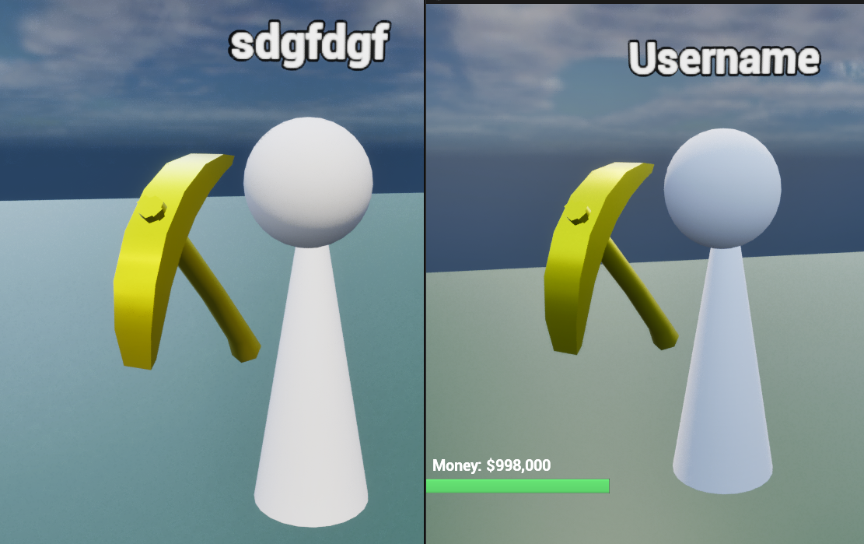
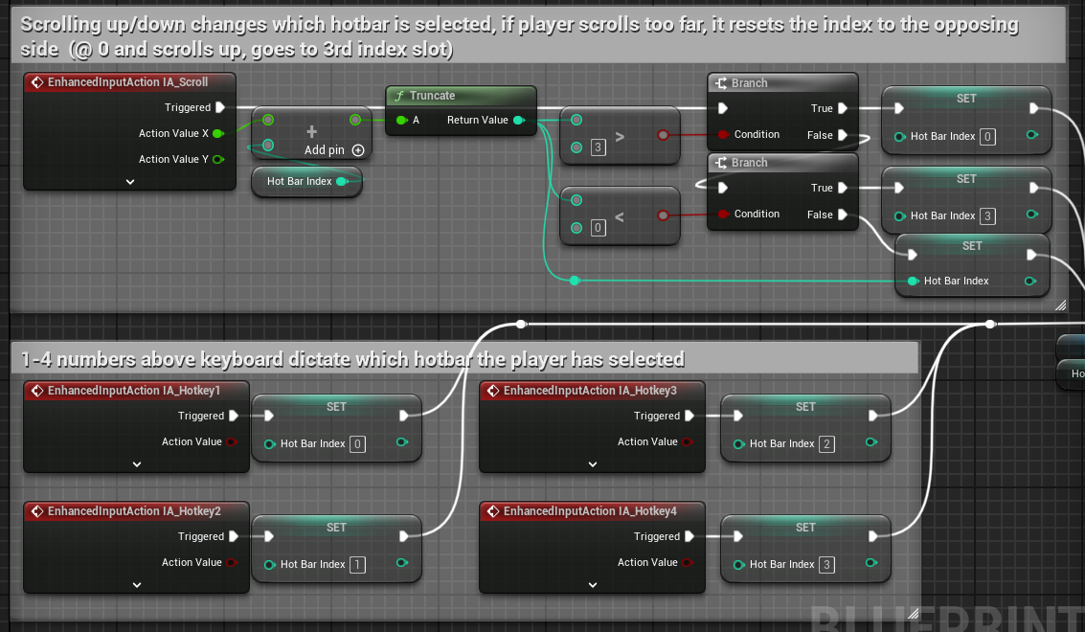
Client Server
Hotbar
UI and Physical
Display's SM and name in UI

Slide 25
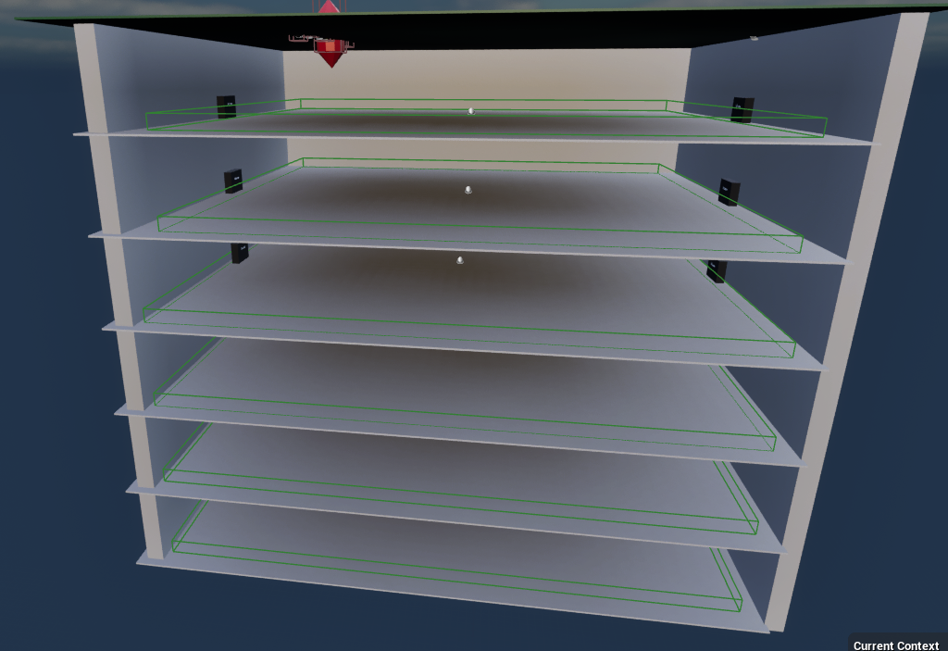
Level Streaming

Slide 26
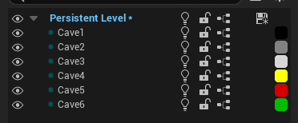
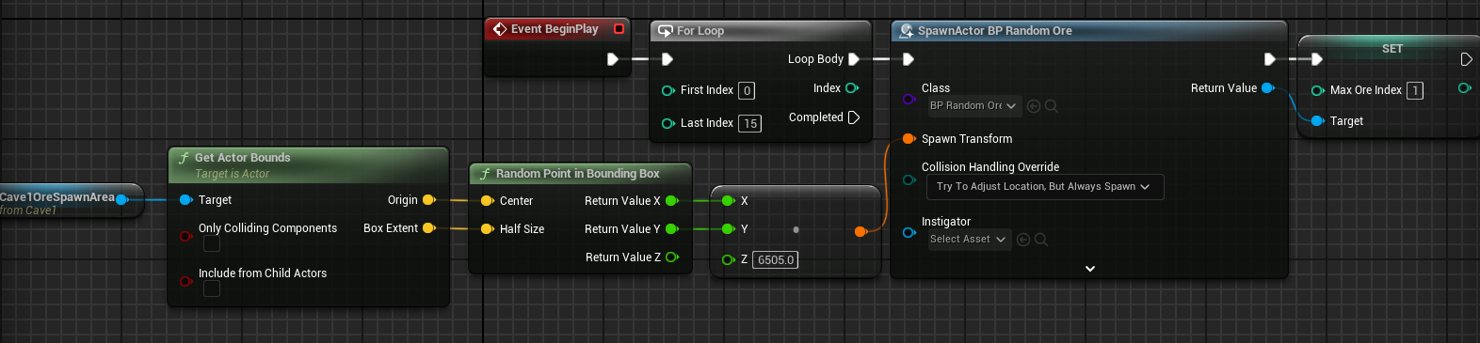
Level Streaming
UE5 integrated system
Uses less RAM
Seamless travel

Slide 27
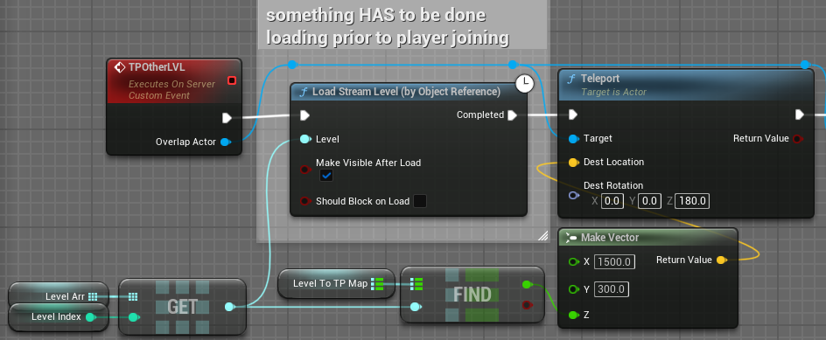
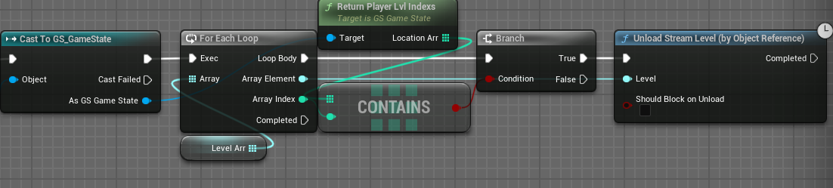
Seamless Travel
TP between levels

Slide 28
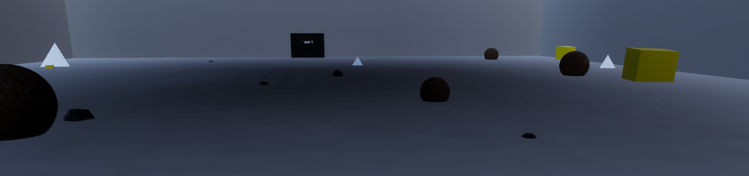
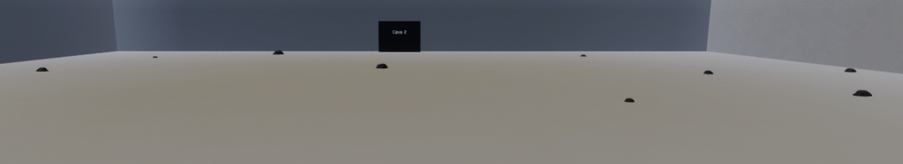
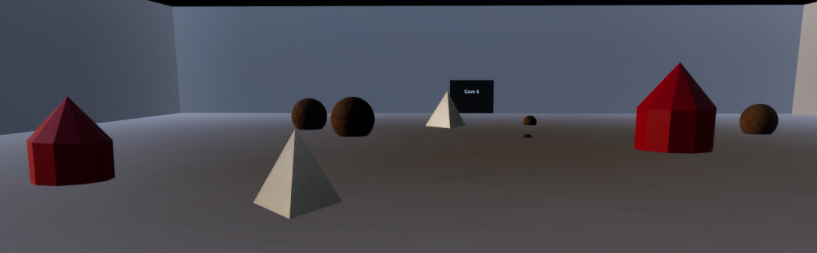
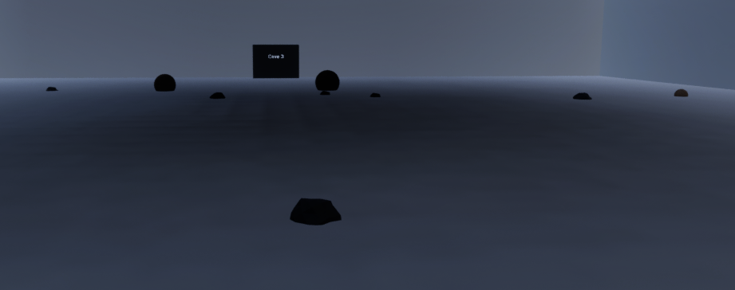
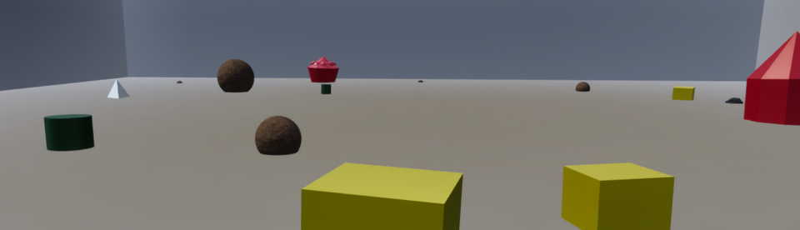
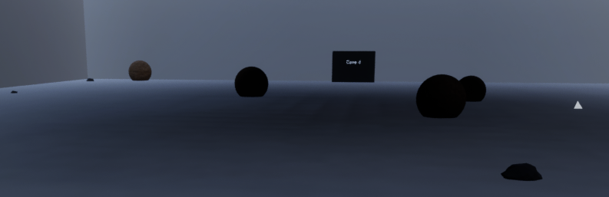
Random ore gen examples

Slide 29



Pause UI

Slide 30


Unfinished features
Enemies
Better Level Design
Lighting
Structures
Polish UI features (for multiplayer)

Slide 31
Questions?
Yes I regret multiplayer

